Slide 1

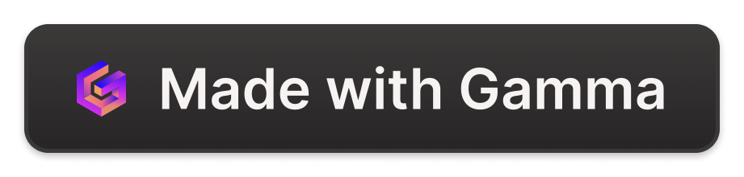
PostIt
Discover the power of PostIt, a revolutionary social media platform created using the MEAN stack. Join in on the conversation and connect with people from around the world.

Slide 2
Table of Content
Overview of the project
Importance of social media in today's world
Technologies Used in the Project
PostIt
Screen Shots
Project Challenges
Project Roles
Key Learnings
Conclusion

Slide 3

Overview of the Project
Get a glimpse into the world of PostIt - its mission, vision, and goal. Understand why this social media project stands out from the rest.

Slide 4
Technologies Used in the Project
MongoDB
Express.js
Powerful database for storing user data and posts.
Robust web application framework for building the server-side infrastructure.
Node.js
React
Efficient JavaScript runtime environment for running the server-side application.
A JavaScript library for building user interfaces.
JWT Tokens
Secure method for transmitting information between parties as a JSON object.

Slide 5

About PostIt
Delve into the heart of PostIt and explore its main features, functionality, and its impact on the social media.

Slide 6
Project Approach
Backend API Setup: Initial development of CRUD operations for tasks.
UI Integration: Integration of the client interface with the existing backend for seamless task management.
Phases: Backend setup, UI design, planned UI enhancements.

Slide 7
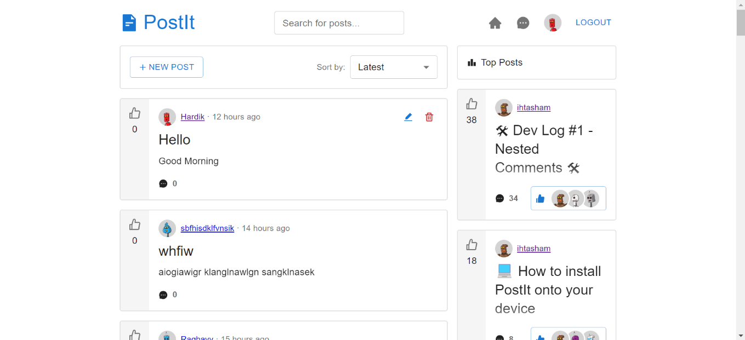
Main Dashboard

Slide 8
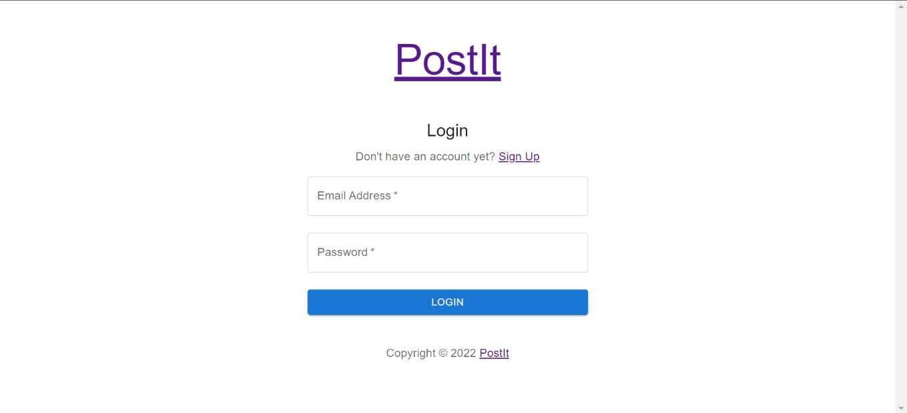
Login Page

Slide 9
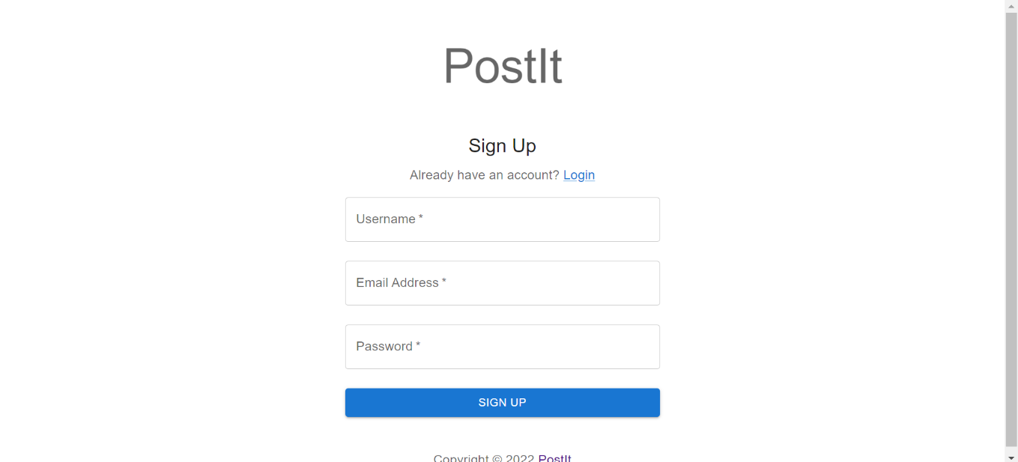
Sign up page

Slide 10
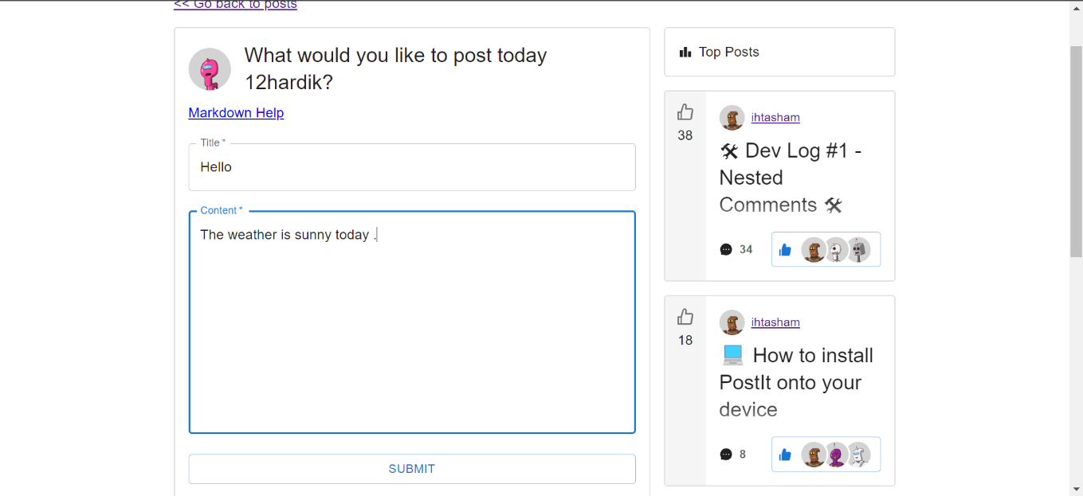
Post

Slide 11
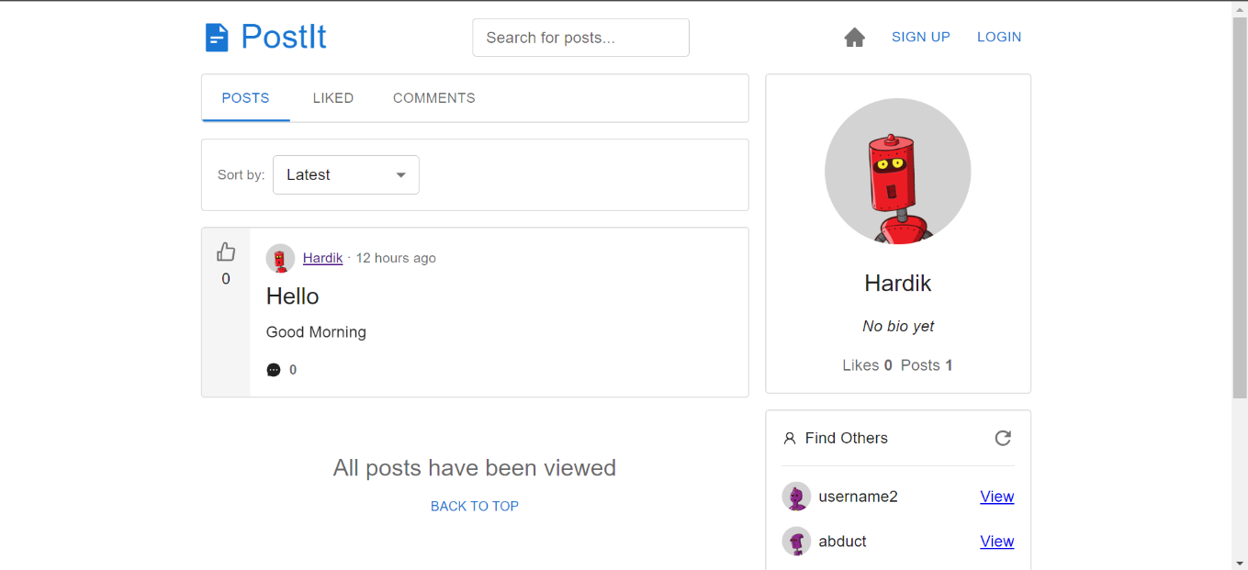
User Profile

Slide 12

Project Demo
Live Demonstration
Experience the power of PostIt through a live demo showcasing its key features and functionalities.

Slide 13

Project Challenges
Discover the hurdles faced by the development team during the creation of PostIt, and how they overcame them to deliver a seamless user experience.
1
Challenges in Development
Integrating the different technologies to ensure optimal functionality and performance of PostIt.
2
Handling High User Traffic
Developing strategies to maintain stability when faced with a large number of users accessing the platform simultaneously.
3
Data Security and Privacy
Implementing robust security measures to safeguard user data and protect privacy in compliance with industry standards.

Slide 14

Project Roles
Hardik Nanda (2110992007)
Atul Sharma (2110992050)
authentication, login page, signup page.
mongodb, database connection.
Shagun Garg (2110991936)
Vishnu Jindal (2110991949)
Javascript and React.
server.js, mongoose, packages instanciate.
Deepankar Kumar (2110992046)
Frontent, react, javascript.

Slide 15

Key Learnings
Agile Development: Embracing an iterative approach to project management and development.
Effective Communication: Importance of clear and regular communication among team members.
learn technologies: like mongodb, express.js, node.js, react, javascript etc.

Slide 16
Future Scope
Expand platform to include mobile app
Integrate with popular third-party tools and services
Implement advanced analytics and reporting features
Enhance collaboration capabilities for team projects
Explore AI-powered features for automated content generation

Slide 17
Conclusion
The integration of a MERN (MongoDB, Express.js, React.js, Node.js) website gives us enhances user experience, engagement, and functionality on the PostIt social media app. By combining a robust web development stack with artificial intelligence capabilities, PostIt provides a dynamic and interactive platform for users to connect, share, and engage with one another. Join us on PostIt and unlock a new era of digital engagement.

Slide 18
References
www.google.com
https://legacy.reactjs.org
https://www.mongodb.com​​​
https://www.youtube.com

Slide 19

Q&A Session
A dedicated Q&A session to address any queries or concerns you may have. Join the discussion and gain deeper insights into the world of PostIt.

Slide 20
Thank You
Expressing gratitude to the audience for their time and attention. Appreciating their presence in the presentation and the support shown towards PostIt.

